Slide 1
U-Care
An Intra-University Student Complaint Portal
Group Number One.

Slide 2
Supervisor
Mrs.Yasotha Ram Ramanan
Senior Lecturer,
University of Vavuniya.

Slide 3
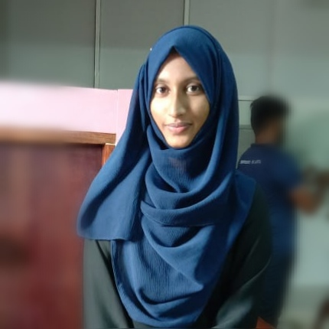
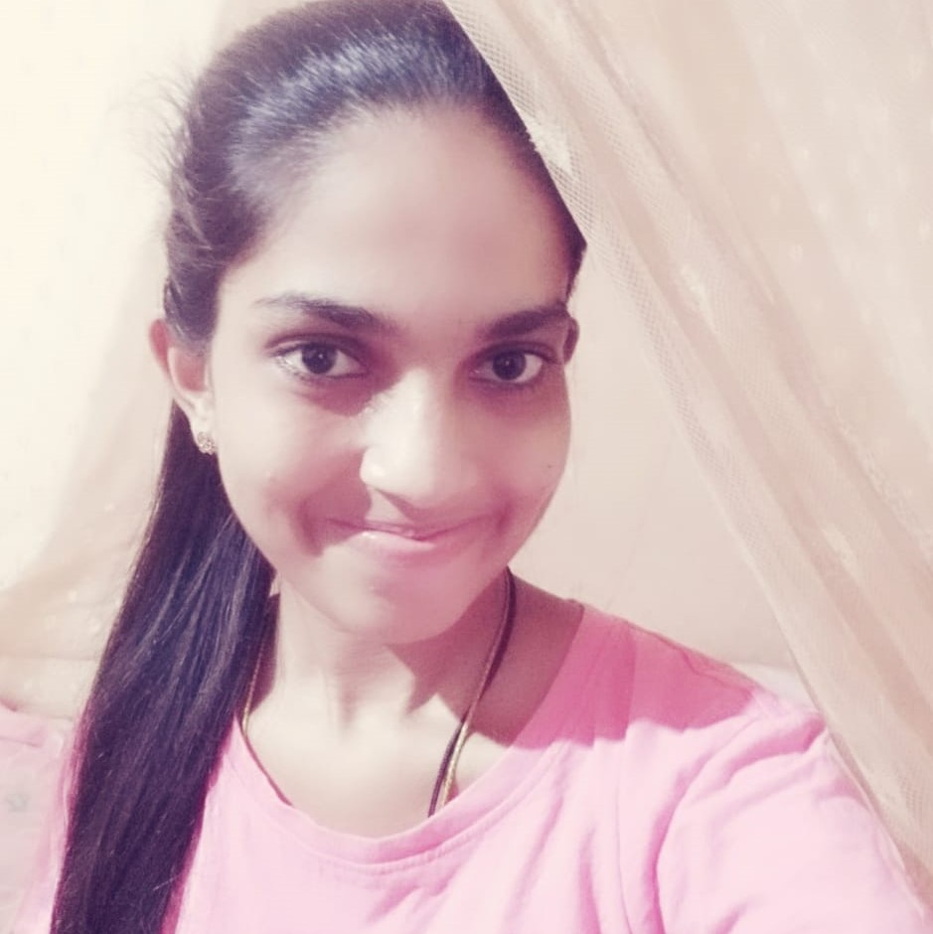
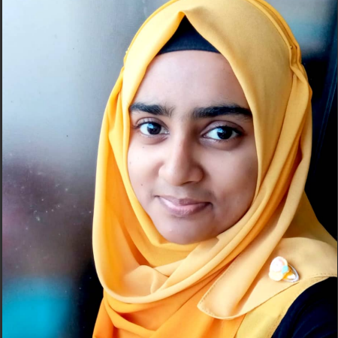
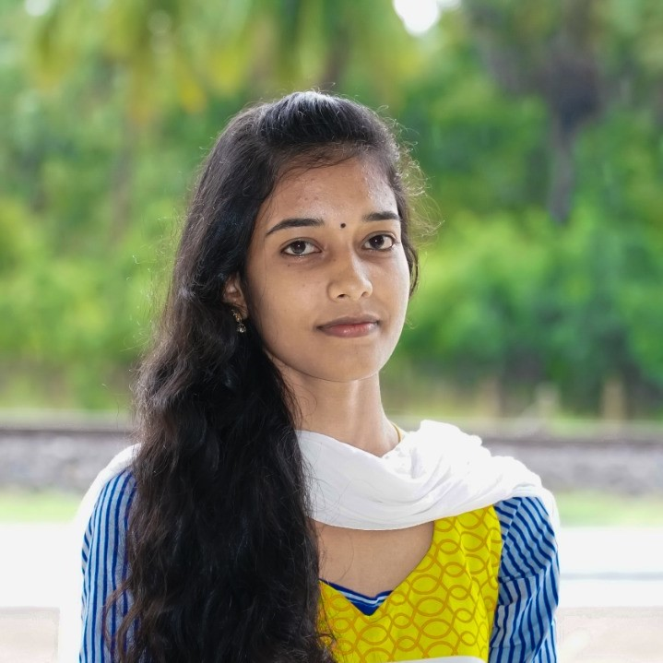
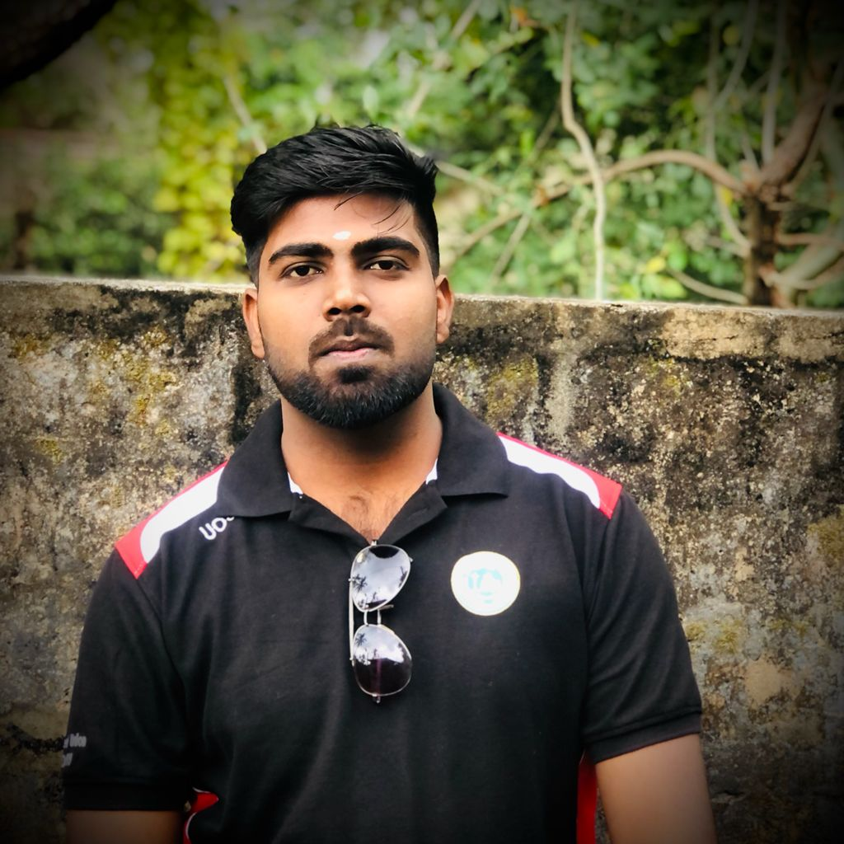
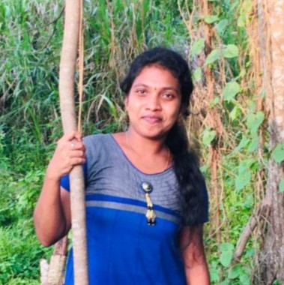
Team Card
Sasna 2017/ICT/17
Project Manager
mn.fathimasasna@gmail.com
Shashini 2017/ICT/44
UI Designer
shashinidias17@gmail.com
Sano 2017/ICT/58
UX Designer
nashathjamaldeen@gmail.com
Tharanika 2017/ICT/86
Android Developer
tharanika2018@gmail.com
Sabananthan 2017/ICT/74
Back-End Developer
saba.nanth@yahoo.com
Keethamy 2017/ICT/53
Quality Assurance Developer keethamythava@gmail.com

Slide 4
Introduction
We are going to develop complains management portal for students of University of Vavuniya.
This is a system which allows the students to express their problems within the University without showing their identity.
These complaints will be seen by a particular team which is assigned for this complaints/problems management.
Through this system the probability of finding the problems of the students will be increased.
Here we like to provide complain facility for students in University level

Slide 5
Introduction
Students can complain to
Students’ Union
Student representative of Faculty Board
complaints management team of University of Vavuniya.
Students can complain against to a
student,
staff and other university related problems
privately or publically.
Regarding
Ragging
Lectures
Canteen
Wash room facilities & other facilities by our University
with Attachments (Image, Audio, Video).
Authenticate by Registration Number and Password.
Using this system we can share University related Information too.

Slide 6
Background
In university life students are facing so many problems related to their university level.
But sometimes they will not execute those problems to the appropriate person or committee
because, they don’t want to show their identity while complaining and they have a fear to tell their statements against high level staffs and unable to go to the related
committee to explain those problems.
Therefore, we have a plan to develop a
Students complaints portal for
University of Vavuniya.
When students spend few minutes here they can
submit their problems via mobile.
By this system they will explain their problems easily.

Slide 7
Background
Design and implementation of complaint management system is to maintain an effective, timely, and equitable complaint handling system which is easily accessible and offered to complainants at no charge.
This project defines the policy and steps for handling and resolving complaints and also to appeal for an un-favored situation and for this process to take place there must be an automation of the system that will be
handle the complaints process and
appeal method of registration.
Automation can be defined as the aspects involved
in using a computer system for the tasks or process
such as circulation, implementation and much more.

Slide 8
Motivation
Our university system has student's complains collecting method
manually such as suggestion box in a particular place to develop the student's environment.
But this is not a reliable method to find all the problems faced by students.
Now all are facing the covid-19 situation and located in distanced places.
With the distanced learning and distanced management we put a solution to detect the problems among the students of Vavuniya University.
So, we planned to make a mobile application to
collect all the problems of students. Which the
complaint, can be posted at any place and any time
without showing the identity of the complainer.
So, this application can help to our University
Management System to find and resolve all the
problems of students peacefully and make the University
environment user friendly for the students.

Slide 9
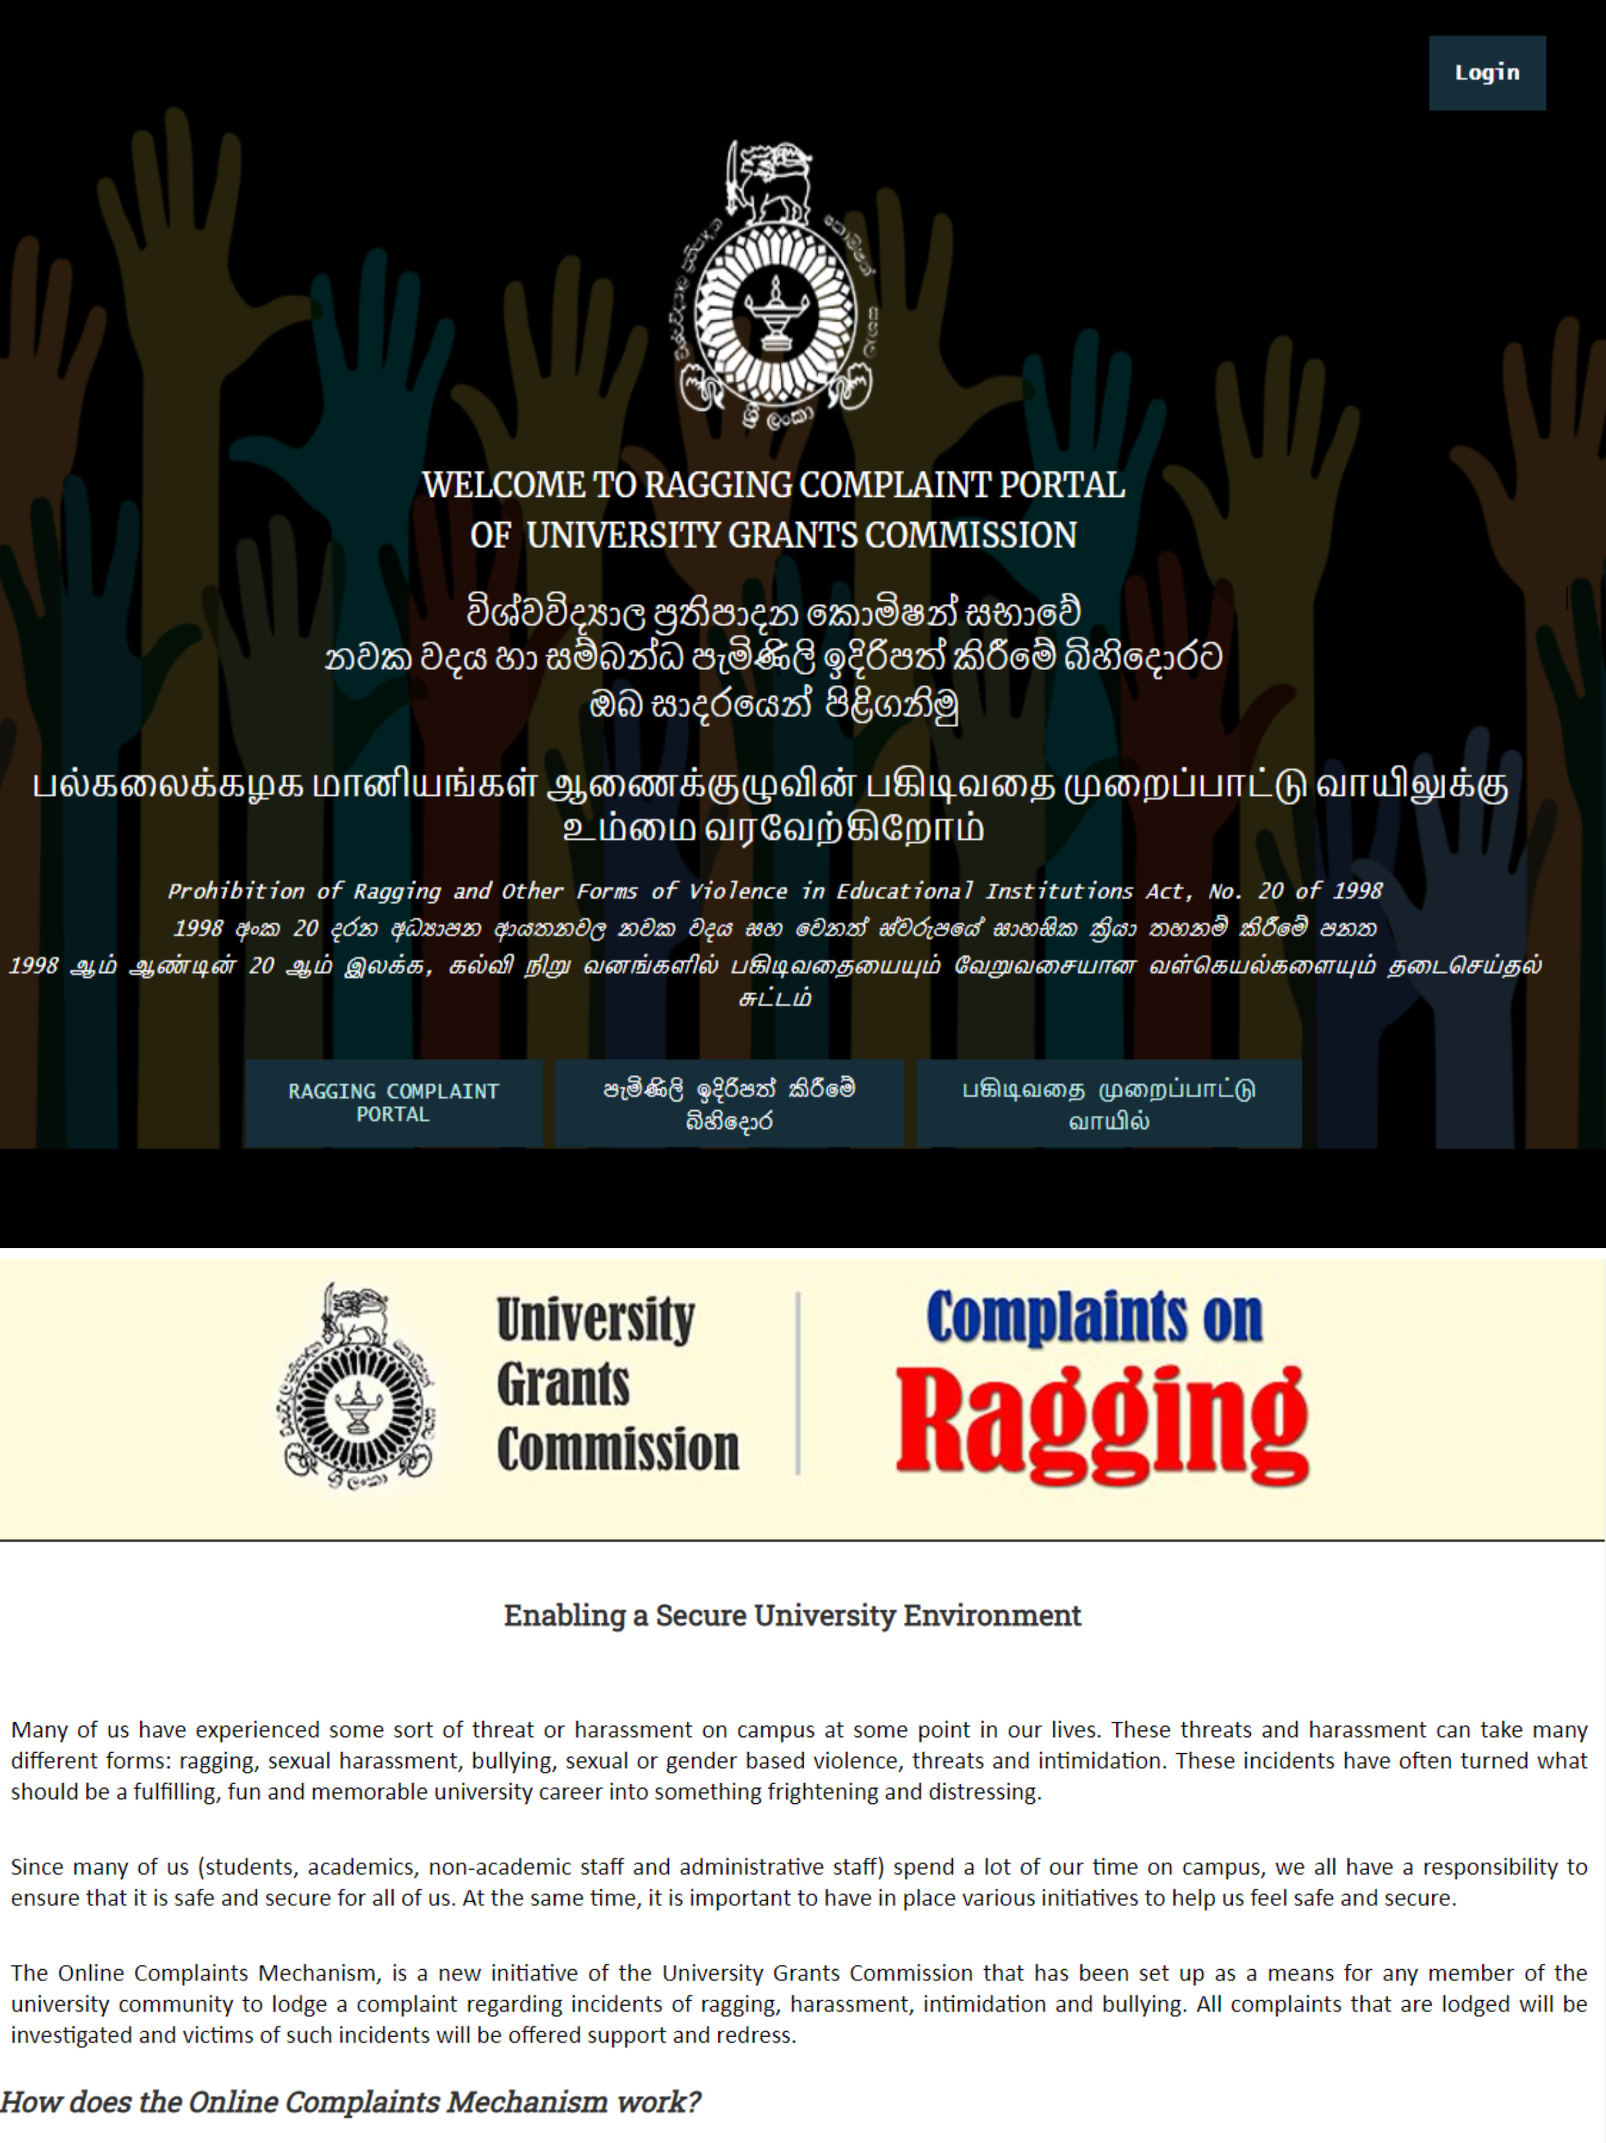
Related Systems
Ragging complaint portal UGC

Slide 10
Ragging complaint portal UGC
Any member of the university can lodge a complaint if they are victims of violence of any form. This includes ragging, bullying and sexual and gender based violence.
Once the complaint is lodged, the relevant authorities (such as the Vice- Chancellor, Student Counsellors etc) are notified and will immediately initiate an investigation regarding the complaint.
A response will be provided to the person who made the complaint within a specified time period.
Protection and support will also be provided by the university to the person who has made the complaint to ensure that he/she is not further victimized as a result of the complaint.
“Ragging complaint portal is a Web based Application From UGC”

Slide 11
Objectives
To develop a student complaint management system which will help in managing complaints or applications received from university students.
To Make complaints easier to coordinate, monitor, track and resolve.
Provide a way to collect the students’ problems.
Reliable method of complaining.
Increase the level of university student’s care
Fast processing of complaints of university students

Slide 12
Functional Requirements
Signup
Students - Student ID
Staffs - Staff ID
Login
User name - Registration Number / Staff ID
Fingerprint identification
Viewers
Public
Private
Categories
Ragging
University Management
Particular Person …
Document Attachments
Photos
Videos
Audio…

Slide 13
Functional Requirements
Received Notifications
Solved Complaints are periodically deleted after particular Days.
One person can have only one account from University of Vavuniya.
Only University Students and Staffs are allowed to use the Application.

Slide 14
Tools & Techniques
Wire Frame - Adobe XD
UX/UI Design - Adobe XD
Front-End - Flutter
Back-End – Fire Base
Data Base - MySQL
Platform - Android Studio/ Visual Studio Code
Frame Works - Flutter
Programming Language - Dart
SDLC Model- Agile

Slide 15
Methodology
User of the System
Students
Students’ Union Members
Student Representatives
Admin Side of the System
Complaints management team
Operator
Database Admin
Student Counselor

Slide 16
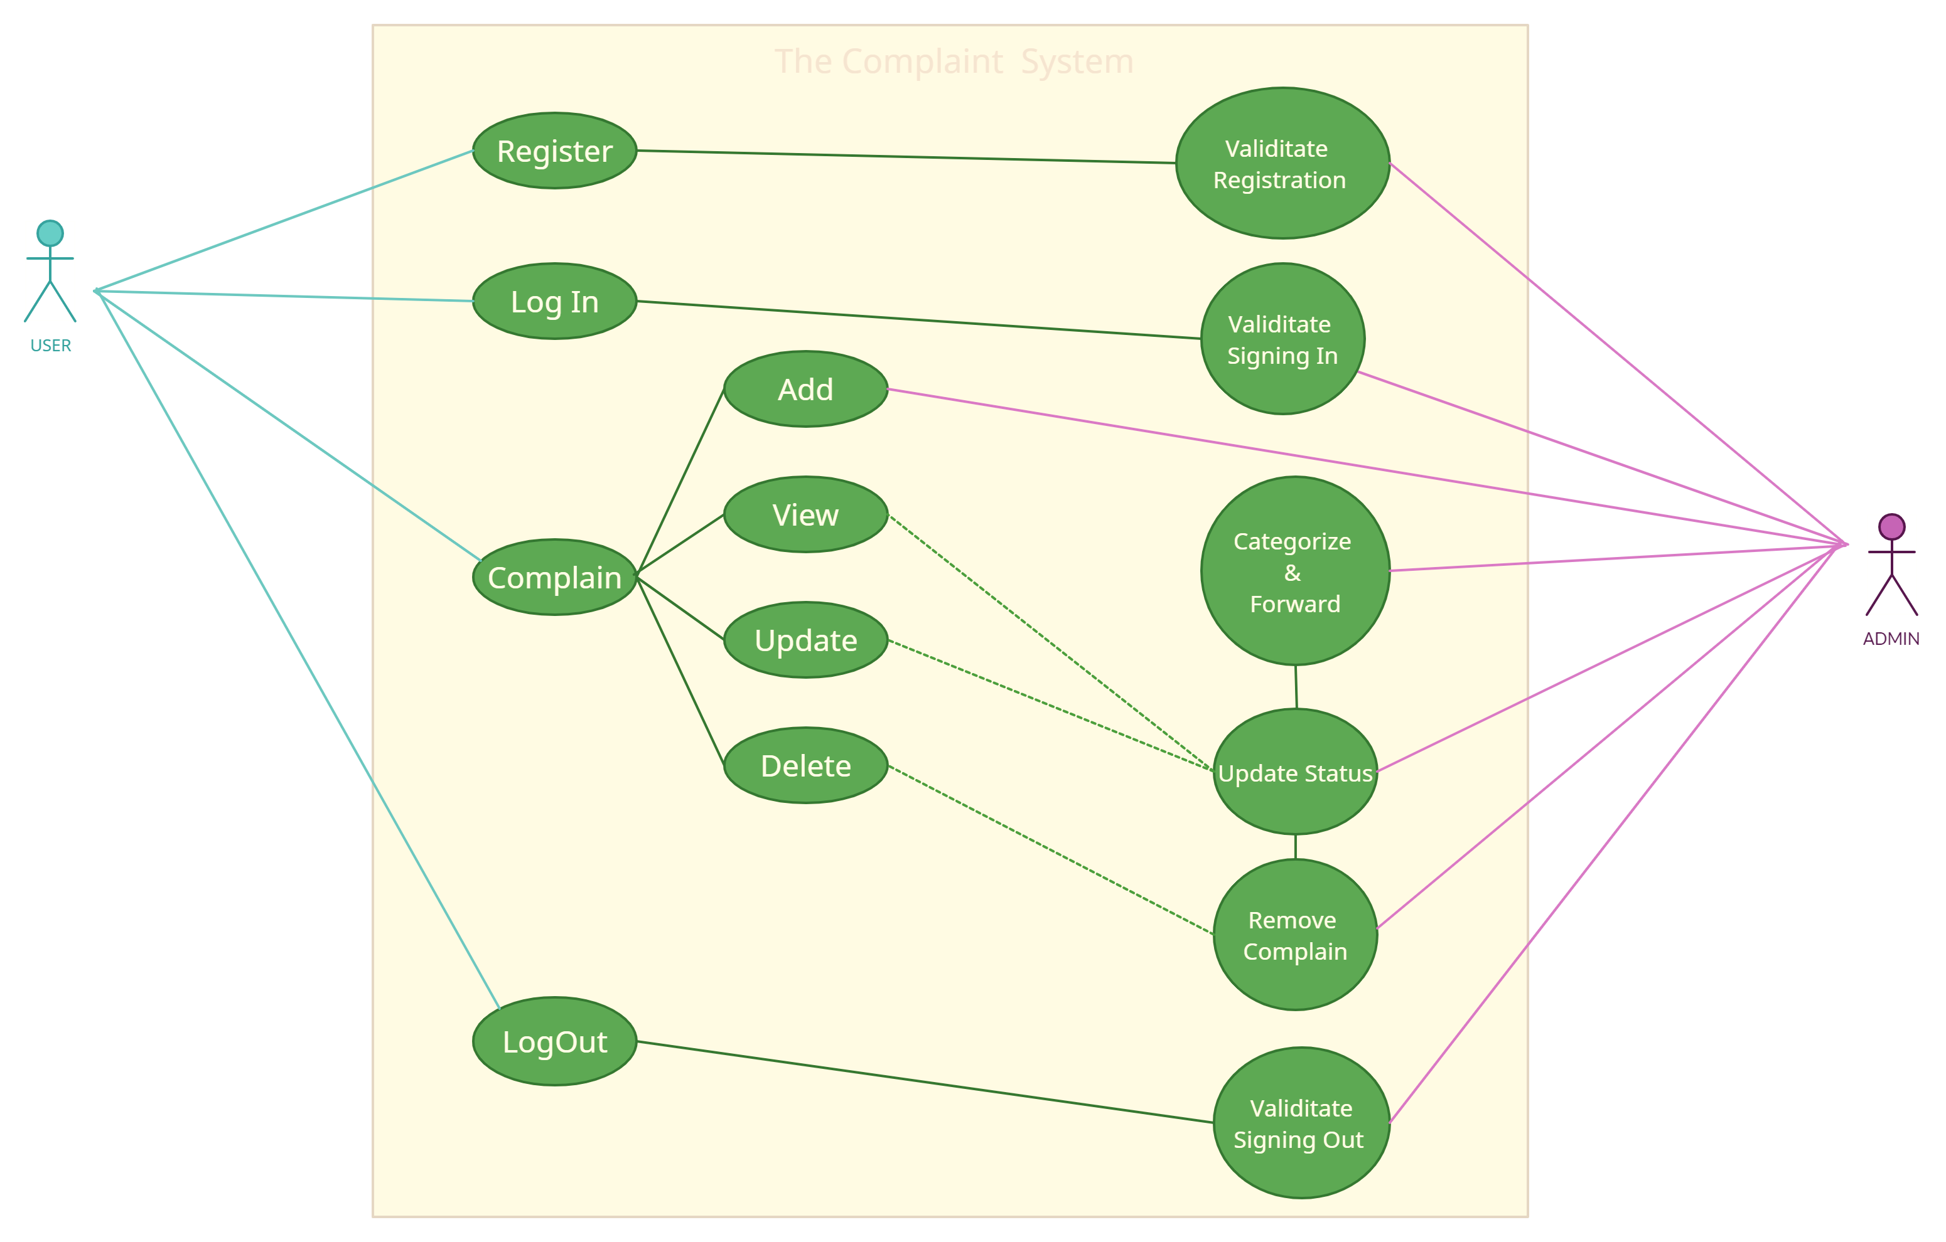
Use Case Diagram

Slide 17
Work Map
Problem Specification
And
Requirement Gathering
Designing Process
And
Approval
Quality Assurance
And
Documentation
1
3
5
2
4
6
Planning
And
Approval
Development
Product Launch
And
Presentation

Slide 18
Gantt Chart
 | Estimated Time ( July 2021- December 2021 )
Month | July | August |  |  |  | September |  |  |  | October |  |  |  | November |  |  |  | Dec
week | 4th | 1st | 2nd | 3rd | 4th | 1st | 2nd | 3rd | 4th | 1st | 2nd | 3rd | 4th | 1st | 2nd | 3rd | 4th | 1st
Topic
Proposal
Gathering Information
Planning
Designing
Implementation
Integration
Testing and Review
System maintenance
Documentation

Slide 19
Specifications
The Mobile Application system which allows students to express their problems drawbacks in the University without showing their identity.
Complaints will be handled by a particular staff member or in-charge or team of members who are assigned to the task specified.

Slide 20
References
https://www.modishproject.com/students-complaints-management-system
https://www.waterintegritynetwork.net/2015/12/03/customer-complaintmanagement
https://policy.usq.edu.au/documents/141630PL
https://eugc.ac.lk/rag/

Slide 21
Thanks!
Any questions?

